Slide 1
Software Design
Software design is a mechanism to transform user requirements into some suitable form, which helps the programmer in software coding and implementation.
It deals with representing the client's requirement, as described in SRS (Software Requirement Specification) document, into a form, i.e., easily implementable using programming language.
The software design phase is the first step in SDLC (Software Design Life Cycle), which moves the concentration from the problem domain to the solution domain.
In software design, we consider the system to be a set of components or modules with clearly defined behaviors & boundaries.

Slide 2
Contd…
Design is a core engineering activity. Design creates a representation or model of the software
The design model provides detail about software data structures, architectures, interfaces and components that are necessary to implement the system.
During the design process the software requirements model is transformed into design models that describe the details of the data structures, system architecture, interface, and components.
Each design product is reviewed for quality before moving to the next phase of software development

Slide 3
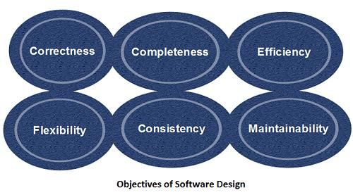
Objectives Of Software Design

Slide 4
Objectives Of Software Design
Correctness: Software design should be correct as per requirement.
Completeness: The design should have all components like data structures, modules, and external interfaces, etc.
Efficiency: Resources should be used efficiently by the program.
Flexibility: Able to modify on changing needs.
Consistency: There should not be any inconsistency in the design.
Maintainability: The design should be so simple so that it can be easily maintainable by other designers.

Slide 5
Software Design Concepts:
Concepts are defined as a principal idea or invention that comes into our mind or in thought to understand something.
The software design concept simply means the idea or principle behind the design.
It describes how we plan to solve the problem of designing software, the logic, or thinking behind how we will design software.
It allows the software engineer to create the model of the system or software or product that is to be developed or built.
The software design concept provides a supporting and essential structure or model for developing the right software

Slide 6
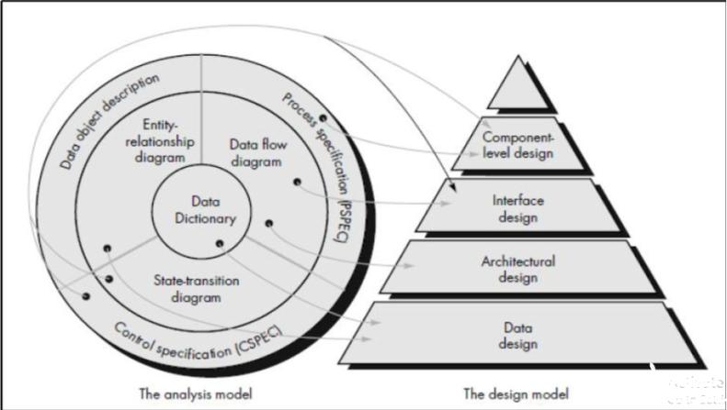
Translating the Analysis model into the Design model

Slide 7
Design Specification Model
Each of the elements of the analysis model provides information that is necessary to create the four models required for a complete specification of design.
1. Data/Class Design: It transforms analysis information model(data dictionary and ER diagram) into data structure required to implement software.
2. Architectural Design: It defines the relationship between major structural elements of the software, it is derived from the system specification, the analysis model and the subsystem interactions defined in the analysis model(DFD). It helps to achieve the requirements defined for the system.
3. Interface Design: describes how the software communicates with each other, with other systems and with human users. The data flow and control flow diagrams provides much necessary information.
4. Component-Level Design: It transforms structural elements of the software architecture into procedural description of software components.

Slide 8
Three characteristics that serve as guide for the evaluation of a good design
The design must implement all of the explicit requirements contained in the analysis model, and it must accommodate all of the implicit requirements desired by the customer.
The design must be a readable, understandable guide for those who generate code and for those who test and subsequently support the software.
The design should provide a complete picture of the software, addressing the data, functional and behavioral domains from an implementation perspectives

Slide 9
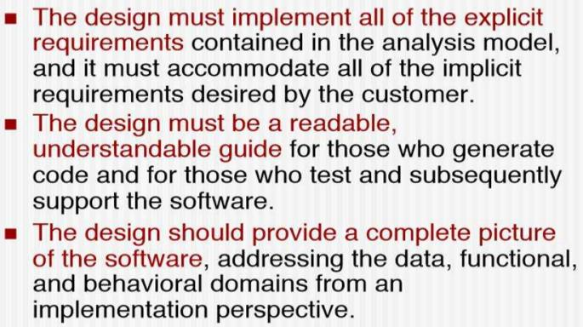
Design And Quality Goals

Slide 10
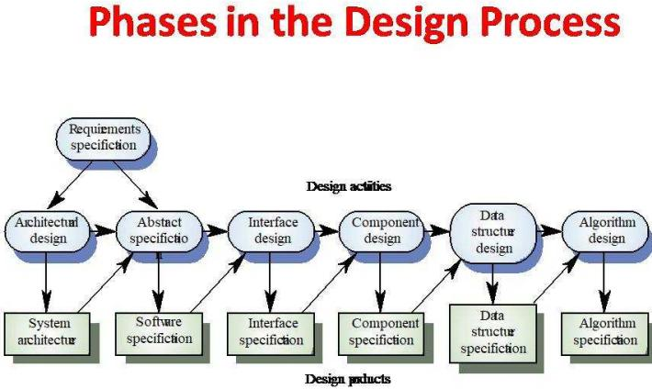

Slide 11
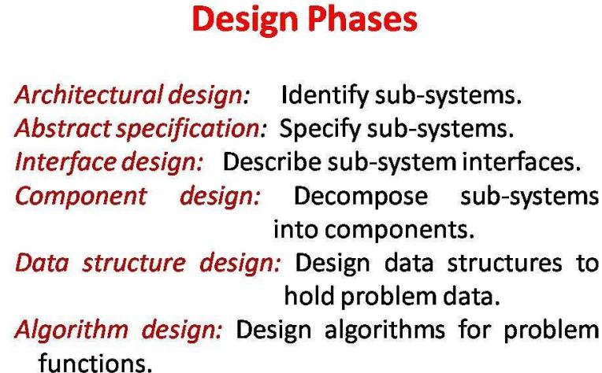

Slide 12
Design Guidelines
A design should exhibit good architectural structure and be modular.
A design contain distinct representations of data, architecture, interfaces and components(modules).
A design lead to data structures that are appropriate for the objects to be implemented and be drawn from recognizable design patterns.
A design lead to components that exhibit independent functional characteristics.
A design lead to interfaces that reduce the complexity of connections between modules and with the external environment.
A design should be represented using a notation that effectively communicates its meaning.

Slide 13
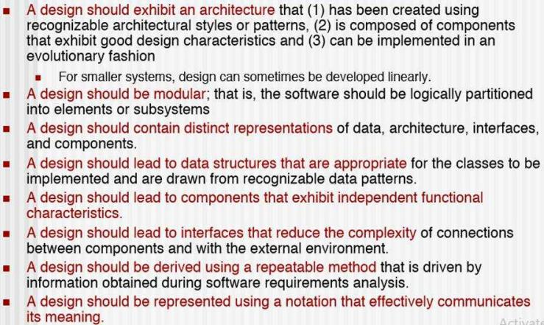
How to achieve the Quality

Slide 14
Design Principles
Design should not suffer from tunnel vision.
Design should be traceable to the analysis model.
Design should minimize intellectual distance between the software and the problem as it exists in the real world should exhibit uniformity and integration.
Design should be structured to accommodate change
Design should be structured to degrade gently, even with bad data, events, or operating conditions are encountered.
Design should be assessed for quality as it is being created.
Design should be reviewed to minimize conceptual(semantic) errors.

Slide 15
Quality Attributes:
The FURPS quality attributes represent a target for all software design
Functionality: is accessed by evaluating the feature set and capabilities of the program, the generality of the functions that are delivered
Usability: is accessed by considering human factors. Overall aesthetics, consistency and documentation.
Reliability: is evaluated by measuring the frequency and severity of failure, the accuracy of output results, the ability to recover from failure.
Performance: is measured by processing speed, response time, resource consumption, throughput and efficiency.
Supportability: combines the ability to extend the program(extensibility), adaptability, serviceability- these 3 attributes represent a more common term Maintainability

Slide 16
Fundamental Concepts In Design
Abstraction- data, procedure, control
Architecture- the overall structure of the software
Patterns- "conveys the essence" of a proven design solution
Separation of concerns- any complex problem can be more easily handled if it is subdivided into pieces
Modularity- manifestation of separation of concerns
Information Hiding- controlled interfaces, no details of algorithms/data
Functional independence- single-minded function and low coupling
Refinement- elaboration of detail for all abstractions
Aspects- a reorganization technique that simplifies the design
OO design concepts.
Design Classes- provide design detail that will enable analysis classes to be implemented.

Slide 17
Abstraction
An abstraction is a tool that enables a designer to consider a component at an abstract level without bothering about the internal details of the implementation.
Abstraction can be used for existing element as well as the component being designed.
Allows designers to focus on solving a problem without being concerned about irreverent lower levels.
Many levels of abstraction can be posed.
At the highest level of abstraction, a solution is stated in broad terms using the language of the problem environment.
At lower levels of abstraction, a more detailed description of the solution is provided.

Slide 18
Contd…
Problem-oriented terminology is coupled with implementation-oriented terminology in an effort to state a solution.
Finally, at the lowest level of abstraction, the solution is stated in a manner that can be directly implemented.
There are two common abstraction mechanisms
Functional Abstraction
Data Abstraction

Slide 19
Functional Abstraction
A module is specified by the method it performs.
The details of the algorithm to accomplish the functions are not visible to the user of the function.
Functional abstraction forms the basis for Function oriented design approaches.
A sequence of instruction that contain a specific and limited function refers in a procedural abstraction.
Data Abstraction
A data abstraction is a named collection of data that describes a data object
Details of the data elements are not visible to the users of data.
Data Abstraction forms the basis for Object Oriented design approaches.

Slide 20
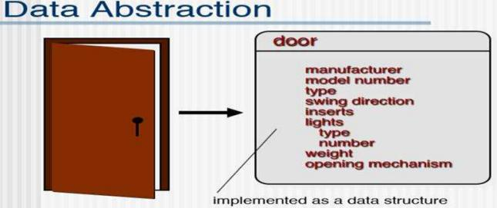
We can define a data abstraction called door.
Like any data object, the data abstraction for door would encompass a set of attributes that describe the door (e.g., door type, swing direction, opening mechanism, weight, dimensions).
It follows that the procedural abstraction open would make use of information contained in the attributes of the data abstraction door.

Slide 21
Refinement
Process of elaboration where the designer provides successively more details for each design component.
Refinement is thus a process where one or several instructions of the program are decomposed into more detailed instructions.
Stepwise refinement is a top down strategy- Basic architecture is developed iteratively - Step wise hierarchy is developed Forces a designer to develop low level details as the design progresses - Design decisions at each stage

Slide 22
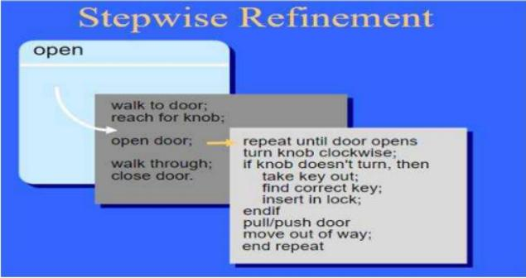

Slide 23
Architecture
The software architecture of a program or computing system is the structure or structures of the system which comprise
The software components
The externally visible properties of those components
The relationships among the components
It refers to the overall structure of the software and structure provides conceptual integrity for a system in a number of ways.
The architecture is the structure of program modules where they interact with each other in a specialized way.

Slide 24
Contd…
Software architectural design represents the structure of the data and program components that are required to build a computer-based system.
The aim of the software design is to obtain an architectural framework of a system.
The more detailed design activities are conducted from the framework.
A good software architecture will yield a good return on investment with respect to the desired outcome of the project, e.g. in terms of performance, quality, schedule and cost.

Slide 25
Why Architecture?
Software Architecture is a representation that enables a software engineer to:
(1)analyze the effectiveness of the design in meeting its stated requirements,
(2)consider architectural alternatives at a stage when making design changes is still relatively easy, and
(3)reduce the risks associated with the construction of the software.

Slide 26
Why Is Architecture Important?
Representations of software architecture are an enabler for communication between all parties (stakeholders) interested in the development of a computer-based system.
The architecture highlights early design decisions that will have a profound impact on all software engineering work that follows and, as important, on the ultimate success of the system as an operational entity.
Architecture "constitutes a relatively small, intellectually graspable model of how the system is structured and how its components work together".
Large Scale Reuse the architecture may be reusable across a range of systems.

Slide 27
Architecture Design
Architectural Design represents the structure of data and program components that are required to build a computer based systems.
It considers the architectural style that the system will take, the structure and properties of the system will take, the structure and properties of the components that constitute the system, and the interrelationships that occur among all architectural components of a system.
The design process for identifying the sub-systems making up a system and the framework for sub-system control and communication is architectural design.
The output of this design process is a description of the software architecture.
It involves identifying major system components and their communication.

Slide 28
Architectural Design Process
Basic Steps
Creation of the data design
Derivation of one or more representations of the architectural structure of the system Analysis of alternative architectural styles to choose the one best suited to customer requirements and quality attributes
Analysis to alternative architectural styles to choose the one best suited to customer requirements and quality attributes
Elaboration of the architecture based on the selected architectural style.
A database designer creates the data architecture for a system to represent the data components
A system architect selects an appropriate architectural style derived during system engineering and software requirements analysis.

Slide 29
Architectural Design Process
System structuring
The system is decomposed into several principal sub-systems and communication between these sub-systems are identified
Control modelling
A model of the control relationships between the different parts of the system is established
Modular decomposition
The identified sub-systems are decomposed into modules

Slide 30
Architecture Attributes
Perfomance
Localize operations to minimize sub-system communication
Security
Use a layered architecture with critical assets in inner layers
Safety
Isolate safety-critical components
Availability
Include redundant components in the architecture
Maintainability
Use fine-grain, self-contained components

Slide 31
Architectural Styles
Each style describes a system category that encompasses:(1) a set of components (e.g., a database, computational modules)that perform a function required by a system, (2)a set of connectors that enable "communication, coordination and cooperation" among components,(3)constraints that define how components can be integrated to form the system,and (4)semantic models that enable a designer to understand the overall properties of a system by analyzing the known properties of its constituent parts.
Data-centered architectures
Data flow architectures
Call and return architectures
Object-oriented architectures
Layered architectures

Slide 32
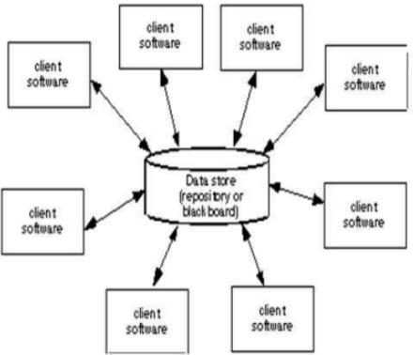
Data Centered Architectures
A data store (e.g. a file or database) resides at the center of this architecture and is accessed frequently by other components that update, add, retrieve or delete data within the store. i.e. Client software accesses a central repository.

Slide 33
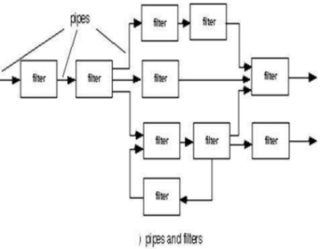
Data Flow Architecture
This architecture is applied when input data are to be transformed through a series of computational or manipulative components into output data.
A pipe and filter structure has a set of components called filters connected by pipes that transmit data from one component to the next. Each processing step is enclosed within a filter component. Data to be processed is passsed through pipes.
Each filter works independently of those components.The filter doesn't require knowledge of the workings of its neighboring filters.

Slide 34
Patterns
A design pattern describes a design structure and that structure solves a particular design problem in a specified content.
Design pattern can be used throughout software design.
One analysis model has been developed, the designer can examine a detailed representation of the problem to be solved. A design pattern is reusable solution to a commonly occurring design problem.
The intent of each design pattern is to provide a description that enables a designer to determine (1) whether the pattern is applicable to the current work, (2) whether the pattern can be reused (hence, saving design time), and (3) whether the pattern can serve as a guide for developing a similar, but functionally or structurally different pattern.

Slide 35
Contd…
Design patterns are adapted for the unique characteristics of the particular problem
There are levels of design patterns:
Architecture Styles/Patterns: These patterns define the overall structure of the software, indicate the relationships among subsystems and software components.
Design Patterns: These patterns address a specific element of the design such as aggregation of components to solve some design problem, component-to-component communication.
Programming Idioms: These language-specific patterns generally implement an algorithmic element of a component , a specific interface protocol, or a mechanism for communication among components.

Slide 36
Modularity
The degree to which software can be understood by examining its components independently of one another.
A software is separately divided into name and addressable components. Sometime they are called as modules which integrate to satisfy the problem requirements.
Modularity is the single attribute of software that allows a program to be intellectually manageable.
It enhances design clarity, which in turn eases implementation, debugging, testing, documenting and maintenance of software product.
Modularity is the single attribute of a software that permits a program to be managed easily.

Slide 37
Contd…
In almost all instances, we should break the design into many modules, hoping to make understanding easier and as a consequence, reduce the cost required to build the software.

Slide 38
Functional Independence
The functional independence is the concept of separation and related to the concept of modularity, abstraction and information hiding.
Functional independence is achieved by developing modules with "single-mined" function and an "aversion" to excessive interaction with other modules
Software with effective modularity, that is, independent modules, is easier to develop because function may be compartmentalized and interfaces are simplified.
Individual modules are easier to maintain(and test)
There are many advantages of modularization in software engineering. Some of these are given below:
Easy to understand the system
System maintenance is easy
A module can be used many times as their requirements. No need to write it again and again

Slide 39
Contd…
Conclusively, functional independence is a key to design, and design is the key to software quality
Independence is assessed using two criteria: Cohesion and Coupling
Cohesion is an indication of the relative function of strength of a module
Coupling is an indication of the relative interdependence among modules

Slide 40
Coupling
The coupling is the degree of interdependence between software modules. A good design is the one that has low coupling
Coupling is the indication of the relationships between modules.
Coupling shows the relative dependence/interdependence among the modules.
Coupling is a degree to which a component/module is connected to the other modules.
While designing we should strive for low coupling i.e. dependency between modules should be less
Making private fields, private methods and non public classes provides loose coupling.
Coupling is Intra-Module Concept.
Two modules that are tightly coupled are strongly dependent on each other. However, two modules that are loosely coupled are not dependent on each other.

Slide 41
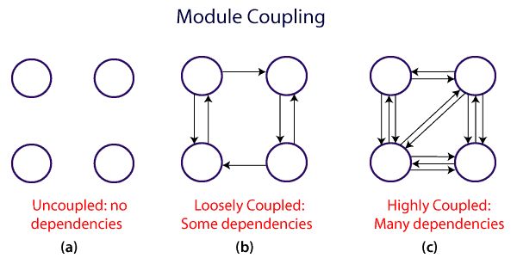
Module Coupling
Coupling is the measure of the degree of interdependence between modules.

Slide 42
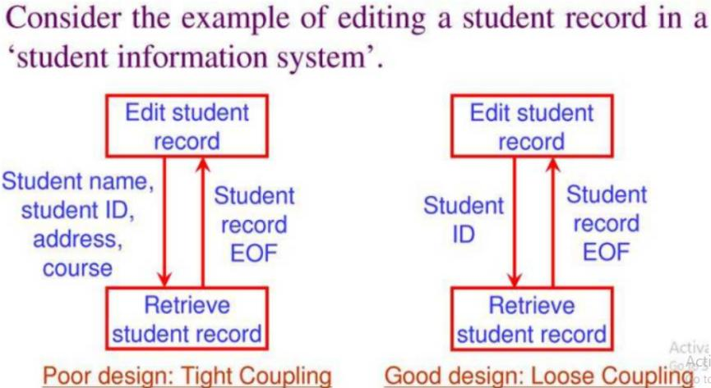

Slide 43
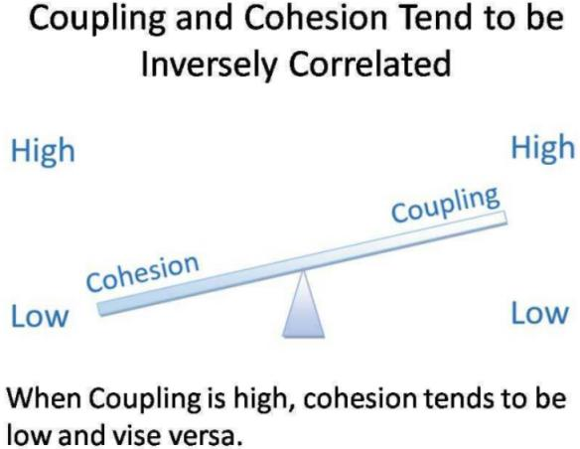

Slide 44
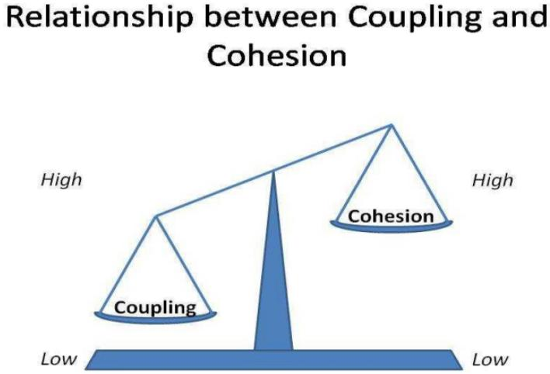

Slide 45
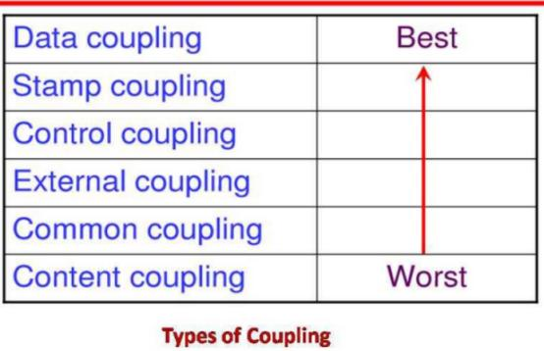
Software Design

Slide 46
Types of Coupling
1. Data Coupling: When data of one module is passed to another module, this is called data coupling.
2. Stamp Coupling: Two modules are stamp coupled if they communicate using composite data items such as structure, objects, etc.
When the module passes non-global data structure or entire structure to another module, they are said to be stamp coupled.
3.Control Coupling: Control Coupling exists among two modules if data from one module is used to direct the structure of instruction execution in another.
4. External Coupling: External Coupling arises when two modules share an externally imposed data format, communication protocols, or device interface. This is related to communication to external tools and devices.
5. Common Coupling: Two modules are common coupled if they share information through some global data items.
6. Content Coupling: Content Coupling exists among two modules if they share code, e.g., a branch from one module into another module.

Slide 47
Cohesion
Cohesion is a measure of the degree to which the elements of the module are functionally related. A good software design will have high cohesion.
Cohesion is the indication of the relationship within module.
Cohesion shows the module's relative functional strength.
Cohesion is a degree(quality) to which a component/module focuses on the single thing.
While designing we should strive for high cohesion i.e. a cohesion component/module focus on a single task (i.e.single-mindedness) with little interaction with other modules of the system.
Cohesion is the kind of natural extension of data hiding for example, class having all members visible with a package having default visibility. Cohesion is Intra-Module Concept.

Slide 48
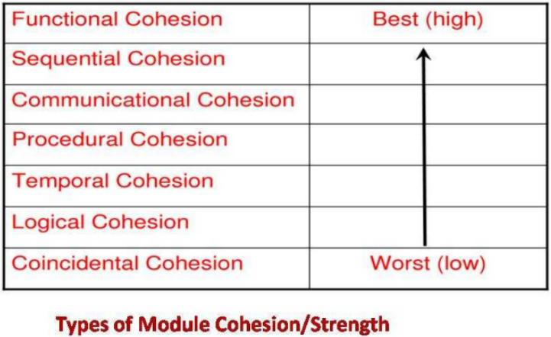

Slide 49
Functional Cohesion: Functional Cohesion is said to exist if the different elements of a module, cooperate to achieve a single function.
Sequential Cohesion: A module is said to possess sequential cohesion if the element of a module form the components of the sequence, where the output from one component of the sequence is input to the next.
Communicational Cohesion: A module is said to have communicational cohesion, if all tasks of the module refer to or update the same data structure, e.g., the set of functions defined on an array or a stack.
Procedural Cohesion: A module is said to be procedural cohesion if the set of purpose of the module are all parts of a procedure in which particular sequence of steps has to be carried out for achieving a goal, e.g., the algorithm for decoding a message.
Temporal Cohesion: When a module includes functions that are associated by the fact that all the methods must be executed in the same time, the module is said to exhibit temporal cohesion.
Logical Cohesion: A module is said to be logically cohesive if all the elements of the module perform a similar operation. For example Error handling, data input and data output, etc.
Coincidental Cohesion: A module is said to have coincidental cohesion if it performs a set of tasks that are associated with each other very loosely, if at all.

Slide 50
Coupling | Cohesion
Coupling is also called Inter-Module Binding. | Cohesion is also called Intra-Module Binding.
Coupling shows the relationships between modules. | Cohesion shows the relationship within the module.
Coupling shows the relative independence between the modules. | Cohesion shows the module's relative functional strength.
While creating, you should aim for low coupling, i.e., dependency among modules should be less. | While creating you should aim for high cohesion, i.e., a cohesive component/ module focuses on a single function (i.e., single-mindedness) with little interaction with other modules of the system.
In coupling, modules are linked to the other modules. | In cohesion, the module focuses on a single thing.

Slide 51
Refactoring
Refactoring is the process of changing a software system in such a way that it does not alter the external behavior of the code, yet improves its internal structure.
Refactoring consists of improving the internal structure of an existing program's source code, while preserving its external behavior.
It is a disciplined way to clean up code that minimizes the chances of introducing bugs. In essence when you refactor you are improving the design of the code after it has been written.
It makes a software system easier to understand and cheaper to modify without changing its observable behavior by changing its internal structure.
The purposes of refactoring according to M. Fowler are stated in the following:
Refactoring improves the design of software.

Slide 52
Contd…
Refactoring makes software easier to understand.
Refactoring helps finding bugs.
Refactoring helps programming faster.

Slide 53
Information Hiding
Modules must be specified and designed so that the information like algorithm and data presented in a module is not accessible for other modules not requiring that information.
The intent of information hiding is to hide the details of data structures and procedural processing behind a module interface. Knowledge of details need not be known by users of the module.
He practice of hiding the details of a module with the goal of controlling access to the details from the rest of the system.
Information hiding or data hiding in programming is about protecting data or information from any inadvertent change throughout the program. Information hiding is a powerful OOP feature. Information hiding is closely associated with encapsulation.

Slide 54
Contd…
Information or data hiding is a concept which protects the data from direct modification by other parts of the program.
The feature of information hiding is applied using Class in most of the programming languages.

Slide 55
Refinement
Refinement is a top-down design approach.
It is a process of elaboration.
A program is established for refining levels of procedural details.
A hierarchy is established by decomposing a statement of function in a stepwise manner till the programming language statement are reached.

Slide 56
Call And Return Architecture
This architectural style enables a software designer to achieve a program structure that is relatively easy to modify and scale.
The program structure decomposes function into a control hierarchy where a "main" program invokes a number of program components, which in turn may invoke still other components.

Slide 57
Object Oriented Architecture
.The properties of inheritance, polymorphism, encapsulation, and composition being provided by OOA come in handy in producing highly modular (highly cohesive and loosely coupled), usable and reusable software applications.
The object-oriented style is suitable if we want to encapsulate logic and data together in reusable components.
Also, the complex business logic that requires abstraction and dynamic behavior can effectively use this OOA.
The components of a system encapsulate data and the operations that must be applied to manipulate the data. Communication and coordination between components is accomplished via message passing.

Slide 58
Client/Server Architecture
This pattern segregates the system into two main applications, where the client makes requests to the server. In my cases, the server is a database with applications logic represented as stored procedures.
This pattern helps to design distributed systems that involve a client system and a server system and a connecting network.
Distributed system model which shows how data and processing is distributed across a range of components.
Set of stand-alone servers which provide specific services such as printing, data management, etc.
Set of clients which call on these services
Network which allows clients to access servers

Slide 59
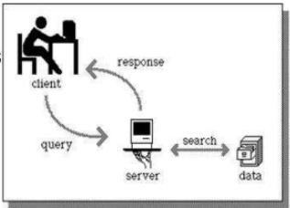
Contd…

Slide 60
Layered Architecture
Oraganises the system into a set of layers (or abstract machines) each of which provide a set of services.
Supports the incremental development of sub-systems in different layers. When a layer interface changes, only the adjacent layer is affected.
A number of different layers are defined,each accomplishing a particular operation.
At the outer layer,components service user interface operations.
At the inner layer,components perform operating system interfacing. Intermediate layers provide utility and application software solutions.

Slide 61
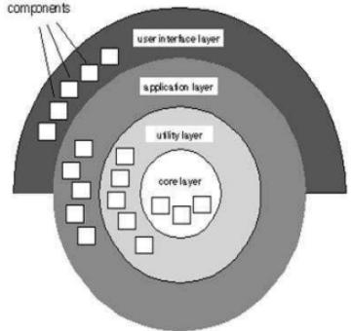

Slide 62
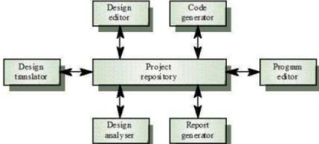
The Repository Model
Sub-systems must exchange data.
This may be done in two ways:
Shared data is held in a central database or repository and maybe accessed by all sub-systems
Each sub-system maintains its own database
and passes data explicitly to other sub-systems
When large amounts of data are to be shared,the
repository model of sharing is mostly commonly used.

Slide 63
Advantages
Efficient way to share large amounts of data
Sub-systems need not be concerned with how data is produced
Centralized management e.g. backup, security, etc.
Sharing model is published as the repository schema
Disadvantages
Sub-systems must agree on a repository data model. Inevitably a compromise
Data evolution is difficult and expensive
No scope for specific management policies
Difficult to distribute efficiently

Slide 64
The Client-server Model
Distributed system model which shows how data and processing are distributed across a range of processors.
Major components:
A set of stand-alone servers which provide specific services such as printing, file management, etc.
A set of clients which call on these services.
A network which allows clients to access these services.

Slide 65
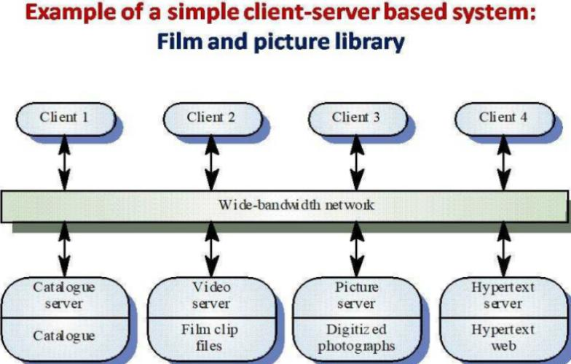

Slide 66
Client-server Model Advantages
Supports distributed computing
Underlying network makes distribution of data straightforward.
No shared data model so servers may organize data to optimize their performance.
Distinction between servers and clients may allow use of cheaper hardware.
Relatively easy to expand or upgrade system.

Slide 67
Client-server Model Disadvantages
Relatively complex architecture-problem determination can be difficult.
No shared data model so data integration may be problematic
Redundant data management activities in each server, possibly.
No central register of names and services, so it may be hard to find out what servers and services are available.

Slide 68
The Abstract Machine(layered)model
Organizes a system into a series of layers.
Each layer defines an abstract machine and provides a set of services used to implement the next level of abstract machine.
When a layer interface changes, only the adjacent layer is affected.

Slide 69
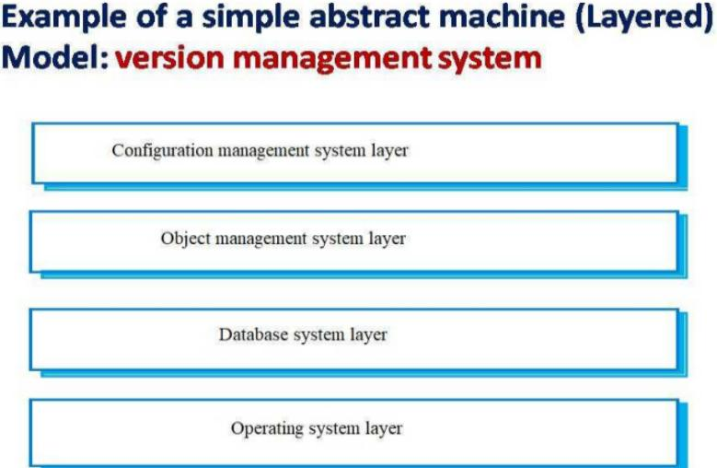

Slide 70
Modular Decomposition Styles
Styles of decomposing sub-systems into modules.
A sub-system is a system in its own right whose operation is independent of the services provided by other sub-systems.
A module is a system component that provides services to other components but would not normally be considered as a separate system.

Slide 71
Modular Decomposition
Two modular decomposition models covered
1)Object Oriented Decomposition
Where you decompose a system into a set of communication objects.
2)Function Oriented Decomposition
Where you decompose a system into functional module that accept input data and transform it into output data.

Slide 72
Object Models
Object-oriented decomposition is concerned with identifying object classes, their attributes and operations.
When implemented, objects are created from these classes and some control model used to coordination object operations.
Object Model advantages
Objects are loosely coupled so their implementation can be modified without affecting other objects.
The objects may reflect real-world entities.
OO implementation languages are widely used.

Slide 73
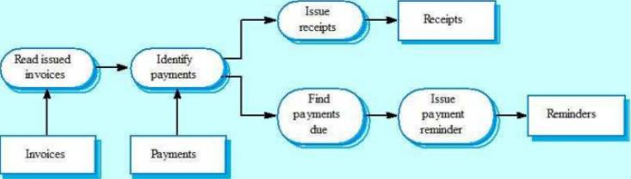
Function-Oriented Pipelining
Functional transformations process their inputs to produce outputs.
May be referred to as a pipe and filter model
Invoice Processing System

Slide 74
Pipeline Model Advantages
Supports transformation reuse.
Intuitive organization for stakeholder communication.
Easy to add new transformations.
Relatively simple to implement as either a concurrent or sequential system.

Slide 75
User Interface Design
UI design is not just about the arrangement of media on a screen
It's designing an entire experience for people, hence a "look and feel"
Psychology: building a mental model
Ergonomics: facilitating navigation

Slide 76
The User Interface
System users often judge a system by its interface rather than its functionality
A poorly designed interface can cause a user to make catastrophic errors
Poor user interface design is the reason why so many software systems are never used
Most users of business systems interact with these systems through graphical user interfaces(GUIs)
In some cases, legacy text-based interfaces are still used

Slide 77
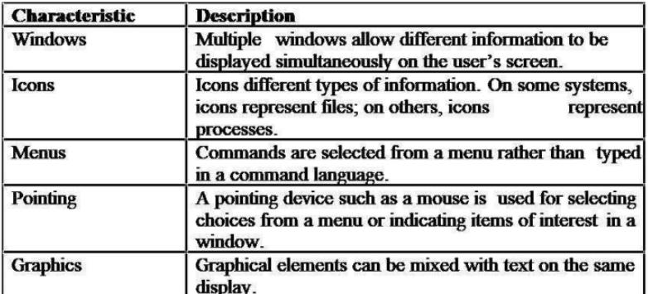
GUI characteristics

Slide 78
UI and UX
The user interface is the graphical layout of an application. It consists of the buttons users click on, the text they read, the images, sliders, text entry fields, and all the rest of the items the user interacts with.
This includes screen layout, transitions, interface animations and every single micro-interaction. Any sort of visual element, interaction, or animation must all be designed. UI designers are graphic designers. They're concerned with aesthetics.
User experience(UX)is determined by how easy or difficult it is to interact with the user interface elements that UI designers have created.
UI designers are tasked with deciding how the user interface will look,UX designers are in charge of determining how the user interface operates.

Slide 79
Contd…
UX designer decides how the user interface works while the UI designer decides how the user interface looks.
UX design is the process used to determine what the experience will be like when a user interacts with your product.
User experience design is an approach to design that takes the user into account
UX is improving how useful, easy, pleasant, marketable, or addictive it is to use a product
UX design is a commitment to building products with the customer in mindedness
UX design is so much more than just designing for a screen
.A successful user interface should be intuitive(not require training to operate),efficient (not create additional or unnecessary friction) and user-friendly(be enjoyable to use).

Slide 80
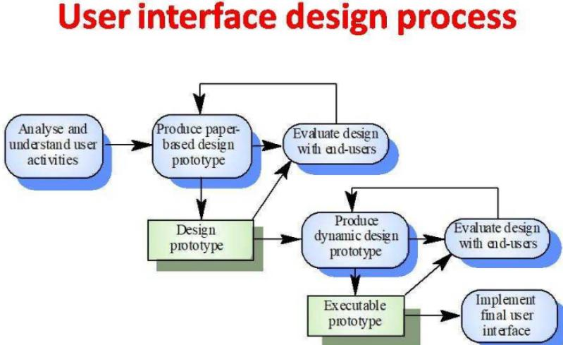

Slide 81
User Interface
User interface is the front-end application view to which user interacts in order to use the software.
The software becomes more popular if its user interface is:
Attractive
Simple to use
Responsive in short time
Clear to understand
Consistent on all interface screens

Slide 82
UI Design Principles
User familiarity
The interface should be based on user-oriented terms and concepts rather than computer concepts
E.g.,an office system should use concepts such as letters,documents,folders etc.Rather than directories,file identifiers,etc.
Consistency
The system should display and appropriate level of consistency
Commands and menus should have the same format,commmand punctuation should be similar,etc.

Slide 83
Contd…
Minimal surprise
If a command operates in a known way, the user should be able to predict the operation of comparable commands.
Recoverability
The system should provide some resilience to user errors and allow the user to recover from errors
This might include an undo facility, confirmation of destructive actions, deletes, etc.
This might include an undo facility, confirmation of destructive actions, deletes, etc.
User guidance
Some user guidance such as help systems, on-line manuals, etc should be supplied

Slide 84
Contd…
User diversity
Interaction facilities for different types of user should be supported
E.g.,some users have seeing difficulties and so larger text should be available
Speak user's language
understandable instructions,feedback,error messages
Anticipation
hide or grey out inactive features

Slide 85
User-System Interaction
Two problems must be addressed in interactive systems design
How should information from the user be provided to the computer system?
How should information from the computer system be presented to the user?

Slide 86
The Various Types Of User Interfaces Include:
graphical user interface(GUI)
command line interface(CLI)
menu-driven user interface
touch user interface
voice user interface(VUI)
form-based user interface
natural language user interface

Slide 87
Guidelines For Form And Report Design
Meaningful titles
clear, specific, version information, current date
Meaningful information
include only necessary information
Balanced layout
adequate spacing,margins,and clear labels
Easy navigation system
show how to move forward and backward,and where you are currently

Slide 88
Introduction To HCI
What is human-computer interaction(HCI)?
HCI is the study and the practice of usability.
It is about understanding and creating software and other technology that people will want to use, will be able to use ,and will find effective when used.
HCI is the study of how people use computer systems to perform certain tasks.
HCI tries to provide us with all understanding of the computer and the person using it, so as to make the interaction between them more effective and more enjoyable.

Slide 89
HCI
Humans interact with computers through a user interface.
This includes software, such as what is displayed on the computer monitor, and hardware, such as the mouse, keyboard and other peripheral devices. As a result, the study of HCI focuses on user satisfaction. Attention to human machine interaction is important, because a poor interface can make it hard for users to benefit from even the simplest systems.
Usability and user experience goal awareness is essential to all HCI design, as follows:
Usability: Central to interaction design and operations through specific computer system criteria,including efficiency,safety,utility and learning/retention.
User Experience: Focuses on creating systems that are satisfying, enjoyable, entertaining, helpful, motivating, aesthetically pleasing, creativity supportive, rewarding,fun and emotionally fulfilling

Slide 90
Contd…
Another consideration in studying or designing HCI is that user interface technology changes rapidly, offering new interaction possibilities to which previous research findings may not apply. Finally,user preferences change as they gradually master new interfaces.

Slide 91
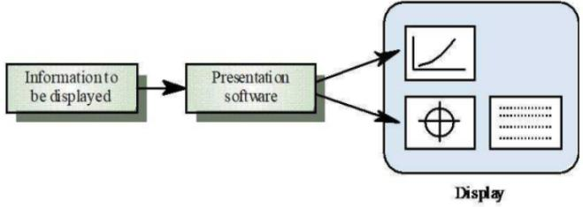
Information Presentation
Information presentation is concerned with presenting system information to system users
The information may be presented directly or may be transformed in some way for presentation
The Model-View-Controller approach is a way of supporting multiple presentations of data

Slide 92
Information Display Factors
Is the user interested in precise information or data relationships?
How quickly do information values change? Must the user take some action in response to a change?
Is the information textual or numeric? Are relative values important?

Slide 93
Analog Vs Digital Presentation
Digital presentation
Compact-takes up little screen space
Precise values can be communicated
Analog presentation
Easier to get an 'at a glance' impression of a values
Possible to show relative values
Easier to see exceptional data values

Slide 94
Tables Vs. Graphs
Use graphs for:
Providing quick summary
Displaying trends over time
Comparing points and patterns of variables
Forecasting activity
Simple reporting of vast quantities of information

Slide 95
User Interface Evaluation
Some evaluation of a user interface design should be carried out to assess its suitability
Full scale evaluation is very expensive and impractical for most systems
Ideally,an interface should be evaluated against a usability specification
However,it is rare for such specifications to be produced

Slide 96
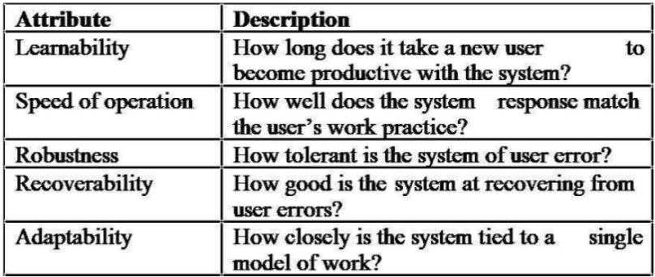
Usability Attributes

Slide 97
Simple Evaluation Techniques
Questionnares for user feedback
Video recording of system use and subsequent evaluation.
Collect information about facility use and user errors.
The provision of a "gripe" button for on-line user feedback.

Slide 98
Assignment Questions
What is architectural? Explain layered model of software architectural with example
What are the objectives of software design? Explain
What are the Software Design Concepts.
What are the Design Phases. Explain
Explain about Quality attributes of software design.
Define Architecture. Write the advantages of it. Explain about the its processes and attributes.
Define modularity and functional independence. How can you achieve the functional independence?

Slide 99
Assignment Questions
Explain about coupling and cohesion. Write advantages of coupling and cohesion.
Define Refinement and refactoring
Define information hiding. How can you achieve information hiding?
Explain about Client-server architecture and repository model. write the advantages of them.
Explain about Modular decomposition and object model .
Define UI and UX.
Explain about HCI

